Slide 1
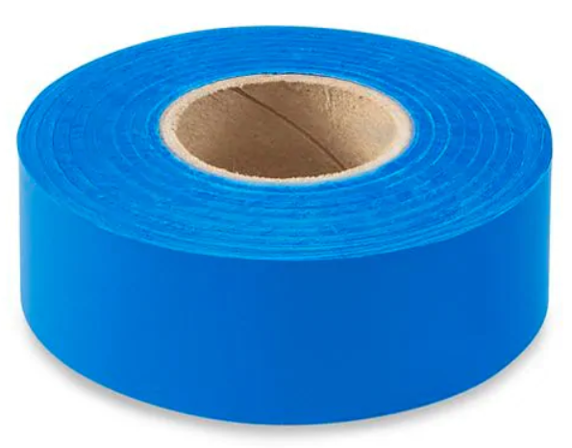
Eliminating the Use of Plastic Flagging to Mark Seedlings

Slide 2
Plastic Policy Working Group
Forests, Lands, Natural Resource Operations and Rural Development (FLNR);
Council of Forest Industries (COFI);
Western Forestry Contractors' Association (WSCA); and
BC Timber Sales (BCTS)
Have formed a “Plastic Policy Working Group” and support the “reduce and eliminate” initiative.
We are hoping to get a joint statement signed by FLNR and WSCA that will set the stage for reducing and eventually eliminating the use of plastic to make trees.

Slide 3
Why should we?
…… It is the right thing to do
There have been incidents of calves ingesting dropped plastic ribbon resulting in sickness and mortality. Impacts to wildlife are unknown. Rabbits are known to ingest this plastic ribbon.
There is growing concern from the ranching community and general public about the use of plastic in the environment. This practice puts over a million rolls of plastic ribbon onto the land base each year.
The planting community have forum discussions on sites such as Replant in which they can see the irony of planting trees as a positive environmentally conscious act and at the same time drop plastic next to them. They also want the practice to be phased out.

Slide 4
How do we coordinate elimination without it disrupting the industry?
innovate and train new planters not to drop ribbon on every tree and wean experienced planters off the practice: “Reduce the Use”.
Use only where seeing trees is impeded by brush etc.
Getting planters calling the ribbon pieces “single use plastic” so that there is a connection to a global context.
Supporting planting contractors through the transition period to address planting density penalties as they adjust to new practices.
Possibly using the contractor rating system to recognize contractors who have single use plastic reduction programs in place and are implementing them.
Encouraging and supporting research and suppliers to source alternatives to plastic ribbon.

Slide 5
Gathering up good ideas
A questionnaire will be sent around to the planting community during this field season to get their opinion and ideas.

Slide 6
Will there be cases where we “need” to use plastic ribbon to mark trees?
Probably until a viable alternative can be found.
Example
It may be difficult for coastal planters to see the location of planted trees when overtopped by slash.

Slide 7
Are there alternatives?
Biodegradable (cellulose not plastic) tape
  More expensive – over double
  Gets soggy in the rain
  Thicker and takes more effort to rip - injury
Chalk
  Respiratory concerns
  Spraying on site or spraying at nursery

Slide 8
Will we introduce legislation?
We don’t anticipate that this will be necessary
Planters want alternatives to plastic
Planting community has been looking at this issue for several years
But ……… it is not off the table.

Slide 9
Newbie trying to follow Vet line during a cluster:
"Are you flagging your trees?"
Vet keeps planting without turning around
"Every tree is a flag."
* Copied from a forum on Replant

